Slide 1
From PhD to Postdoc: a toolkit
Objective: Obtaining the postdoctoral position that best prepares you for your future career goals
Target audience: Undergraduate and graduate students, postdoctoral fellows looking to change laboratory

Slide 2
Outline
Exploring career options and deciding what you want to pursue
Building the skills and network needed for career advancement
Identifying and securing the right postdoctoral position
Planning for future career advancement

Slide 3
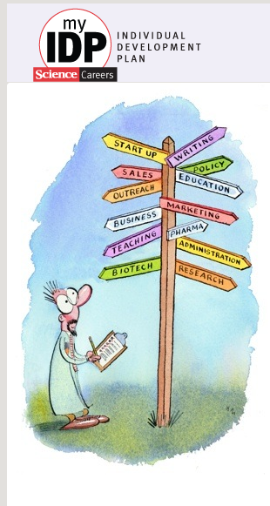
1. Career options & explorations
Before you consider applying for a postdoctoral position:
Explore your career options
Chose what best fits your interests, goals and values
Start thinking about career advancement early in your PhD training
What are some tools you can use?
Individual Development Plan
Informational interviews (meetings with experts in different careers)
Career Counselors/University Trainee Office
Science Careers (AAAS)
http://myidp.sciencecareers.org
Notes:
Visit http://myidp.sciencecareers.org for exercises to help you examine your skills, interests, and values; a list of 20 scientific career paths with a prediction of which ones best fit your skills and interests; a tool for setting strategic goals for the coming year, with optional reminders to keep you on track; and articles and resources to guide you through the process.
Informational interviews can stem from your network or by participating at expo events and career fairs, such as https://www.nature.com/naturecareers/career-expo or the NeuroJobs Career Center at the SfN annual meeting.
Additional resources can be found through Science Careers, AAAS at this link: http://www.sciencemag.org/careers/career-resources.
In addition, InterSECT is a job simulator which will give you an idea of what working in different sectors is like https://intersectjobsims.com/library/.

Slide 4
Individual Development Plan
http://myidp.sciencecareers.org
Notes:
An Individual Development Plan or IDP is mandated for trainees supported on NIH grants. An IDP suggests career options following a self-assessment questionnaire. An IDP also allows you to set goals to improve your skills and create connections to prepare for your desired career path. You are encouraged to continue to develop and implement your IDP throughout your training years, as your goals, interests, and skills develop and change.

Slide 5
What are employed PhDs doing in the US?
Of 787,000 employed scientists and engineers surveyed in 2015, 41% were primarily doing Research and Development (R&D).
government
31,000
3.9%
of total
academia
137,000
17.4% of total
private sector, for-profit
124,000
15.8% of total
Source: National Science Foundation, Survey of Doctorate Recipients, 2015
Notes:
The majority of PhD recipients in the US are employed outside of academia.

Slide 6
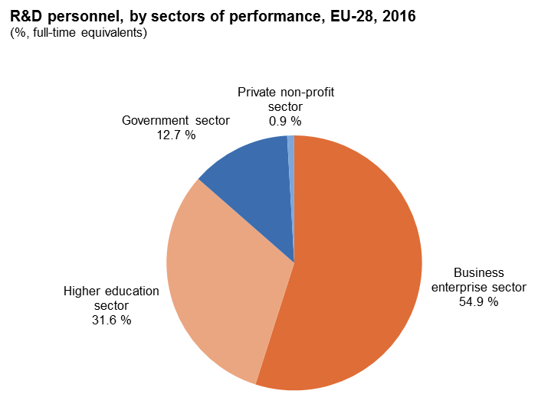
The R&D sector can be different in different regions
Each country and political/economical area is different, for instance in the EU, most of the total population directly employed in R&D works outside academia
Source: Eurostat
Notes:
Data on PhD employment are limited in the EU and other countries, but general information on R&D employees draws a similar picture. You may need to explore whether specific industries value doctoral and postdoctoral experience.
References
https://ec.europa.eu/eurostat/documents/3217494/9087772/KS-02-18-728-EN-N.pdf/3f01e3c4-1c01-4036-bd6a-814dec66c58c
https://ec.europa.eu/info/sites/info/files/srip-report-full_2018_en.pdf

Slide 7
Do you need to do a postdoc?
In the US, the remaining 59% employed PhD scientists and engineers primarily work in: other science or non-science related professions
Teaching
Education
Admin
BSc
Journalism
Information media
Education
Communication
Note: Many career options do not require further postdoctoral training
PhD
Law
Business
Science Policy
Patent
Intellectual Property
R & D
Biotech Startup
Venture Capital
Postdoc
Independent Investigator
Academia and Government
R&D in Biotech/Pharma
Notes:
Many careers that can be pursued with a PhD (such as teaching, intellectual property, science communication or policy) do not require a postdoc. You will have to determine what you would want to do and what actions to take to get there.

Slide 8
Postdoctoral opportunities outside of academia
Several postdoctoral positions are available outside of the traditional academic path
Postdoctoral programs at pharmaceutical companies (Merck, AstraZeneca, Genentech, Lilly and others)
Postdoctoral position in government agencies such as NIH, FDA, CDC, etc.
Postdoctoral opportunities in academia working on drug discovery as part of the Academic Drug Discovery Consortium (ADDC)
Check the Careers/Jobs tabs on their websites to search for these opportunities
Notes:
There are multiple positions for postdoctoral fellows outside of academia that can give you an idea of how research in other organizations is run. Go to the company websites or Google “postdoc AND (company name)” to find opportunities.
To learn more about academic programs in drug discovery go to the Academic Drug Discovery Consortium (ADDC) website http://addconsortium.org/index.php.

Slide 9
Questions to ask yourself
What type of work do you want to do and what do you want to learn?
Do you enjoy working at the bench?
Do you like writing? Teaching? Helping others?
Is there something you want to avoid doing?
Do you prefer being part of a team?
Do you see yourself as a leader/manager?
In what area/sector do you want to do this work?
Academia, pharma, government, non-profit…
Do you want a stable job? Or are you comfortable with changing/moving often?
How do you handle stress and competitive pressure?
What do you have to offer in terms of expertise, skills, ability?
Use your Individual Development Plan to ask these and other questions
Notes:
The following resources may be useful as you explore career paths:
http://myidp.sciencecareers.org/
tps://intersectjobsims.com/library/
https://neuronline.sfn.org/Articles/Career-Paths/2016/Making-the-Switch
https://neuronline.sfn.org/Articles/Career-Paths/2017/Biomedical-Career-Options-for-Scientists-and-Physician-Scientists

Slide 10
2. Key skills for career advancement
Core competencies to be acquired during graduate education
Conceptual Knowledge
Research Skill Development
Rigorous and Responsible Conduct of Research
Communication Skills
Career Development and Professionalism
Notes:
There are specific core competencies to be developed during your doctoral training. Most of these are transferable to any job.
Core competencies were described by the Neuroscience Training Committee of the Society for Neuroscience at this link: http://www.sfn.org/Careers/Higher-Education-and-Training/Core-Competencies.

Slide 11
Assess your skills in these domains
Conceptual & Research Skills:
Rigorous study design and development
Understand complex content
Gather and integrate a lot of information
Problem solving
Intellectual independence
Achievement & Self-Adjustment:
Learn and adapt quickly
Perform under pressure
Meet high expectations
Work independently
Take initiative
Communication & Interpersonal Skills:
Written and oral proficiency
Listening and understanding
Convey complex info to experts and non-experts
Work collaboratively
Thrive in multi-disciplinary environments
Leadership
Conflict management
Which of these skills do you still need to develop to reach your future career goals?
Adapted from Jean Branan,, Program Coordinator, Career & Postdoctoral Services @ The Scripps Research Institute
Notes:
Think about your current work experience. As an early-career researcher it may be challenging to think about what professional skills you have, but you likely already have developed some of these skills and could aim to develop additional skills during your PhD. These soft skills undoubtedly relate to jobs and can be pulled from a multitude of early career accomplishments and activities.
Which of these skills do you have and which ones do you need to develop for your chosen profession?

Slide 12
Transferable skills to many careers
Skills needed for the larger job market
Writing and communication skills
Time and project management skills
People management and team-work experience
You have already gained these skills by:
Organizing your experiments
Writing grants and papers
Working with others in your lab and other labs
Notes:
You can assess your transferable skills using myIDP (http://myidp.sciencecareers.org/), other online resources, or with the support of a career coach.

Slide 13
Opportunities for skill building during PhD
Attend career development workshops
Join and engage in professional societies
Build and nurture relationships with multiple mentors and sponsors
Mentors offer advice and guidance
Sponsors influence and elevate your career
Advocates champion and represent you to others
Participate in service and leadership activities
Choose opportunities that meet a specific interest or offers a tangible reward
… And NETWORK everywhere you go!
Notes:
There are multiple opportunities online and in person to develop new skills. Look at some of these options and start identifying people that can help you in your career advancement either by teaching you new skills or by introducing you to their contacts.
You can learn more by viewing the video recording of a SfN Professional Development Workshop called “Navigating Career Transitions in Neuroscience”. The video recording can be viewed at this link: https://neuronline.sfn.org/Articles/Career-Paths/2018/How-to-Navigate-Career-Transitions-in-Neuroscience.

Slide 14
Build a mentoring team
Committees with multiple mentors have become the norm for PhD training
Each mentor may have a specific role inside and outside academia depending on what you need
Scientific expertise, industry experience, teaching, balancing work with a family, applying for jobs
Prepare before the meeting with ideas and topics to discuss
Many mentoring relationships develop out of informal interactions
A discussion over lunch at a conference can be a mentoring moment
A peer or friend can be a mentor or connect you to mentors
A mentoring relationship is built over time
Don’t be afraid to reach out. People (generally) love to talk about their research/jobs.
Notes:
Do not limit mentorship to only your PhD mentor because one person cannot provide all the insight and training that you need for career development. Identify what type of mentoring you need for the desired skillsets you need/want and reach out to build a mentoring team.
Additional information can be found within the Neuronline article titled Your Science Avengers: How to Assemble Your Mentoring Team, which is available at this link: http://neuronline.sfn.org/articles/professional-development/2017/your-science-avengers-how-to-assemble-your-mentoring-team.

Slide 15
Networking for career transitions
Networking is an essential skill for professional development
Consists of developing and maintaining a group of supporters who can help you advance in your research and your career
Networking with your peers can be as important as networking with senior scientists
Allows others to learn about you and your research training and career goals
Share through direct conversation, research proposals, or your CV/résumé
Can lead to collaboration and new training opportunities
Gives you access to information about the career track and environment (“insider” information)
Learn specifics about various lab environments/cultures
Notes:
Networking is essential not only to find mentors and sponsors, but also to meet colleagues and collaborators. Networking with your peers is as important as networking with senior scientists and can be a lot more informal and less stressful.
https://medium.com/@samanthazy/10-tips-for-easier-networking-at-scientific-conferences-bde2a8ccc72a

Slide 16
Tips for networking effectively
Be yourself!
Start where you are comfortable through people you already know
Develop an “elevator pitch” to introduce your self: 2-3 non technical sentences about your interests, background and goals
Be strategic
Target individuals in labs/research areas to which you aspire
Use scientific conferences to meet with potential research advisors or collaborators
Be honest and direct
Communicate what you need and how others may help you
Follow up and stay connected
Check in, share updates, ask for help/guidance
Be a resource and help others achieve their goals
Make introductions, offer help, be a peer-mentor
Notes:
Additional information about how to successfully network can be found at the following links:
http://www.utm.utoronto.ca/careers/resources-for-graduate-students/academic-careers/networking-and-developing-your-presence
https://www.jobs.ac.uk/careers-advice/working-in-higher-education/573/how-to-develop-successful-networking-skills-in-academia

Slide 17
3. Career advancement via postdoc training
The main goal of the postdoctoral training is to acquire additional transferable skills towards your next career goal
Technical skills
Further conceptual knowledge
Communication skills (publications, presentations)
Leadership/management skills
Expanding your professional network
A postdoctoral research experience should prepare you for the transition of trainee to independent researcher and allow you to develop an independent area of research/expertise
Postdoctoral training is required for some careers (and career advancement) in academia, government and industry/pharma
Notes:
Why do a postdoc? Find out more at this link: http://www.nationalpostdoc.org/page/GradStudentChoose.

Slide 18
Resources for finding a postdoc position
Direct contact with researchers online via email or on social media on Twitter, ResearchGate, and LinkedIn
Job Advertisements:
Society for Neuroscience (https://neurojobs.sfn.org/jobs)
FENS jobs and other societies
Journal websites: Science Careers, Nature Jobs
National Postdoc Association (http://careers.nationalpostdoc.org)
University websites
Research Professional
Euro ScienceJobs
Notes:
As is true for any job, there are multiple places to look for a postdoc position and you should explore different possibilities on job resources like LinkedIn Job Search, but also company and government websites. Remember to look at scientific societies and laboratory websites.
Learn from one trainee’s experience about finding the right position at this link: https://neuronline.sfn.org/Articles/Career-Advice/2017/How-This-Postdoc-Found-a-Position-Right-for-Her.

Slide 19
Applying for a postdoc position
Plan and prepare for your postdoc search one year before you plan to defend
Make contact with PI(s) you want to work with and/or their lab members before you apply
Meet with the PI if they are invited for a seminar or invite them through the seminar committee
Schedule a meeting with the PI at a conference
Get to know the PI’s lab members and alumni at conferences
Obtain information about success of potential postdoc PI's trainees
Be prepared and follow-up with PI
Have a 2-3 minute elevator pitch ready and your business card
Keep potential PI advisor updated on your progress (manuscripts, pre-prints, defense date)
Identify fellowships that are suitable and beneficial for you to apply for
Notes:
Look for the right environment to fit your career goals.
Do they have a list of alumni that you can reach out to?
Do the postdocs usually go on to independent faculty positions or to good industry jobs?
Does their lab environment suit your needs and style of work?
Make contact before you apply to make sure your application will not be overlooked. If the PI is invited to give a seminar at your institution meet with them with your advisor or go to the trainee lunch. You can also invite them yourself through the seminar committee or schedule a meeting at a conference. Often, getting to know lab members informally at a conference can also help get you an interview and obtain insider information on the lab environment.
Nobel Laureate Martin Chalife provides advice on what makes a good postdoc application at this link: https://www.youtube.com/watch?v=x2fBwH6CupA.

Slide 20
Your application materials
A curriculum vitae or résumé is an opportunity to effectively advertise your experience and expertise for a particular position
Your Skills
Employer Need
Your Value
Adapted from “Transforming your CV or Resume: Insider Tips for Any Position,” SfN Webinar, 2015
Notes:
Your application materials should show that you have the skills to meet the employer's needs and therefore must be tailored to the specific position to which you are applying and highlight the skills the employer wants/needs (meaning, what does their position description say they are looking for in a new hire?).
You may have multiple versions of your CV or résumé , depending on the position you are applying for.

Slide 21
Using a CV vs résumé
 | Curriculum Vitae | Résumé
Description | A comprehensive list of your full educational and professional history | A summary of your qualifications and skills that are relevant to a specific position
Typical use | Academic positions, some research positions (government, industry) | Some research positions (industry), non-research positions
Focus | Academic achievements and experience | Relevant skills and expertise
Length | Dependent on experience; no page limit | Usually 1-2 pages
Notes:
Some positions will require a more comprehensive CV that gives an exhaustive list of your work and achievements, while others require a résumé that is a summary of your skills and relevant work experience. Know which type of documentation is requested/required.
Remember, you may have multiple versions of a CV or résumé depending on the position to which you are applying.
Resources:
https://www.training.nih.gov/assets/Writing_a_CV.pdf
https://www.training.nih.gov/assets/Guide_to_Resumes_&_Curricula_Vitae.pdf

Slide 22
Tips for building a CV or résumé
Tailor your CV/résumé for the specific position to which you’re applying
Your relevant experience/skills should match the position
Use terms/keywords of the job description to show how you meet job requirements and preferred qualifications
Highlight both technical and transferrable skills
Use action verbs to describe your expertise and accomplishments (designed, developed, led, evaluated, initiated, etc)
Format for ease of reading
Include plenty of white space
Bold key info
Use bullet points rather than paragraphs
Notes:
For more information on this topic, watch the SfN webinar called “Transforming Your CV or Resume: Insider Tips for any Position”. The webinar is available at the following link: http://www.sfn.org/Careers/Higher-Education-and-Training/Core-Competencies.

Slide 23
Typical interview
Initial interview via phone or video chat (i.e. Skype or Google Hangout)
In-person interview, if possible
Give research talk to lab group
Meetings with lab members
Meetings with faculty with similar interests
Meeting with Postdoctoral Office representatives (if applicable)
Virtual interview, if in-person visit not possible (international candidates):
Ask for phone/skype meetings with lab members
Notes:
There could be different formats for the interview, but in general you must be ready to explain your science and to ask questions about the science and environment of the lab.

Slide 24
Preparation for the interview
It is important that you know the research of the laboratory
Read the primary papers from the lab from the last few years
Look up SFN or other society abstracts (from past year)
Be prepared to answer questions about your work and how it fits in with the lab to which you're applying
Be prepared to ask questions about the PI's work and other related projects
Review university website for additional training/professional development opportunities and benefits
If meeting with other faculty, know their recent papers and be comfortable with discussing their work

Slide 25
Postdoc compensation and negotiation
Know the cost of living and what you will need for your personal life/family planning in order to establish your minimum requirements
Search for average salary at the national level and the institution(s) to which you apply
Determine the length of the postdoc contract before funding runs out
You may need to secure your own funding (fellowship) to start or continue your work
Know the details of the offered salary + benefits package
Health insurance benefits, retirement benefits, paid leave/sick days, paid maternity/paternity leave
Identify additional perks that can stretch your salary, such as relocation reimbursement and university subsidies (housing, day-care, retirement, etc.)
Notes:
As you evaluate any job you must define whether the salary, benefits and other perks work with your personal or family planning. In addition to the starting salary, there are many things that can stretch you money: health insurance, retirement fund, additional perks such as gym or emergency babysitting, relocation expenses, university subsidized housing or daycare, funds for personal laptop and career development workshops.

Slide 26
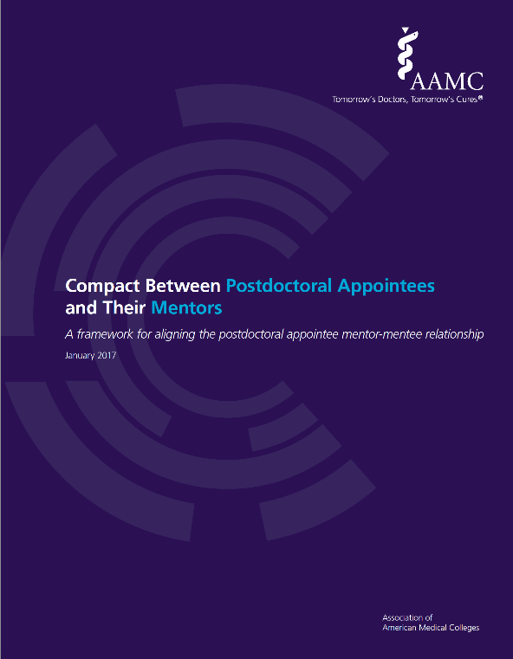
Important topics of discussion / negotiation
Things to consider in the broad discussion with your postdoc mentor/supervisor about the relationship you will have:
Research projects and publications
Training and teaching opportunities (internships)
Support for fellowship and other grant applications
Transition to independence
Career development for positions outside of academia
It is important to regularly meet with your mentor/supervisor to check the progress of and revise these topics as often as necessary.
Notes:
Here presenters should stress the importance of mentor and mentee responsibilities and rights. The AAMC developed an excellent compact that can be used to outline the relationship between a postdoc and their mentor at this link: https://www.aamc.org/initiatives/research/postdoccompact/. Additional information about building an effective mentor/mentee relationship can be found within the video recording of SfN’s Optimizing the Mentor-Mentee Relationship professional development workshop, which is available at the following link: https://neuronline.sfn.org/Articles/Professional-Development/2017/Optimizing-the-Mentor-Trainee-Relationship.
You may be worried about asking the PI about career development for positions outside of academia. Consider asking the lab members about this first in casual conversation. Also, make sure the PI understands the complexities of the current job market. You want a mentor who will have your back, no matter what.

Slide 27
How to negotiate effectively
Knowing how to ask for what you need and negotiate if necessary is a critical professional skill.
Define what you need and why this would be good for you and the lab
You need higher salary because you want to live close to the lab, so that you don’t have to commute
Be open, honest, and direct about your needs and justify why they are important
The dollar amount for your salary may not be adjustable, but you can negotiate other accommodations, benefits, and perks
Subsidized housing on campus
Funds for a personal laptop
Ability to telework as needed
Notes:
Negotiating effectively takes some training and skill. You want to be open and honest, but also be strategic in how you ask for money or benefits, sometimes asking for a bit more than you need and accepting a compromise offer.
These resources about academic negotiation can also be helpful for postdocs:
http://www.sciencemag.org/careers/2001/08/be-honorable-and-strategic
https://career.ucsf.edu/sites/career.ucsf.edu/files/PDF/Academic-Careers-Job-Negotiations.pdf
https://www.sfn.org/sitecore/content/Home/OMP/Articles/Career-Advice/2018/Learn-How-to-Be-Successful-in-an-Academic-Career

Slide 28
Negotiate for your career progression too
You chose to do a postdoc but are still considering job opportunities in industry, teaching, or publishing…
Ask about opportunities for further career development
Active postdoc office
Protected time and funds for career development activities
You may be worried about asking the PI because they may think you are not fully committed to academia
Ask the lab members first in casual conversation
Make sure the PI understands the complexities of the current job market
Notes:
Is is important to understand if the PI is invested in your future. Ask PI and lab members about the careers/outcomes of postdoc alumni and the support provided to postdocs by the department and institution at large (available travel funds, ability to take or audit classes, opportunities for cross-training at another lab, etc).

Slide 29
4. Building a career through a postdoc
Things you need to be competitive in the academic job market:
Quality publications
Grants
Teaching experience
Time, people, and money-management skills
Leadership skills
Continue to expand your mentoring team as your career development needs progress/change
Remember that many of the skills acquired during PhD and postdoc training are transferable to any job, inside and outside academia
Engage in training opportunities that fit your short- and long-term career goals
Notes:
As you start your postdoc, think about what your long term goals are and plan for them, while also preparing a contingency plan for other career options. You may get some of these skills from your PI mentor/supervisor, your department, your university, professional society membership, external professional development courses, etc. Identify what skills you need and find opportunities to build and strengthen those skills.
A couple helpful resources include:
https://neuronline.sfn.org/Articles/Career-Advice/2018/Learn-How-to-Be-Successful-in-an-Academic-Career
https://neuronline.sfn.org/Articles/Career-Advice/2018/How-to-Select-and-Plan-for-a-Postdoc

Slide 30
Publish or perish?
Publications are still the measure of productivity for a postdoc and showcase your research and your creativity.
First authorship is essential and means you led the project
Balance risky and safe projects
High-profile publications are preferred in high-profile universities, but are NOT sufficient to get a job
Discuss clearly with your advisor what is expected of you.
Long gaps in publishing (>5-6 years) are a “red flag” for search committees, even if a high-profile paper is obtained at the end.
Strive for the best, while keeping an eye on your productivity. Be pragmatic.
Notes:
Define with your mentor what their expectations are about publishing. Beware if they will only accept top impact papers and will not allow you to publish part of your work, since you may have portions of your work that will remain unpublished.

Slide 31
Get grants! It’s all about the money!
For research-intensive positions, the ability to conduct fundable research is key
Having a funded proposal is a huge plus for your CV
Faculty search committee meetings are often told to look at how much money the applicant has secured
Identify fellowships (both foundation and federal) you can apply to and mark deadlines in your calendar
Remember that eligibility to many career development grants expires 3-5 years after your PhD graduation date
A combination of postdoctoral fellowships (your salary) and transition to independence awards (other salaries and supplies) is best
You should familiarize yourselves with federal grant structure and review process
Notes:
Searching for funding opportunities takes time, as does generating preliminary data. You have to balance bench work with grant writing, since many postdoctoral fellowships have deadlines based on your PhD graduation date.
Here are some suggestions for how to look for fellowships:
https://asntech.github.io/postdoc-funding-schemes/
https://www.researchprofessional.com/0/rr/funding.html

Slide 32
Tips for writing an effective grant
Start Early
Develop a Strategy
Plan Your Application
Address All Review Criteria
Submit All Required Components
Work with your advisor on the following:
Review organization’s research priorities and goals
Identify funding opportunities that match your needs
Identify experienced mentor(s) and collaborators if necessary
Learn about the application and review process
Make early contact with program officers to discuss your interest in applying
Study successfully funded grant applications
Write clearly and concisely for reviewers to understand your proposed work
Notes:
Suggested reading: Scientific Writing and Communication: Papers, Proposals, and Presentations. Angelika H. Hofmann

Slide 33
Should you care about teaching?
Teaching opportunities for postdocs are limited, but teaching is a part of your application and interview in academia
You may decide you want a teaching job
For a research position teaching is not critical, but it helps
Arrange guest teaching in a friend’s or mentor’s courses
Teach sessions or workshops for friends/colleagues
Actively mentor grad students and undergraduates
For a teaching position you need to have developed curriculum, i.e. your own courses
Have a clear conversation with your advisor about your goals
Serve as teaching assistant (TA) for your advisor or adjunct at a nearby university
Take teaching courses available at your university
Look for teaching fellowships
Notes:
Teaching experience is critical to obtain a teaching position and even for research positions you may need to outline your teaching philosophy.
There are programs available for postdocs that combine research and teaching: https://www.nigms.nih.gov/Training/CareerDev/Pages/TWDInstRes.aspx.

Slide 34
So much to do, so few hours…
Balancing experiments with writing grants and papers requires time-management skills. Learning to prioritize and switch among different activities is important for any job.
Set relevant milestones and keep the focus to reach them. Make a long term plan for the next 6-12 months.
Track the deadlines and progress: productivity apps, paper calendar, Google calendar, whatever works for you
Discuss the timeline with your advisor
Negotiate protected time for writing or other activities (e.g. exclusive access to equipment)
Get advice on feasibility of timeline and get them on board with the plan (writing letters, paying for conferences)
Notes:
Effective time management is not taught in graduate school, but it’s one of the most important skills in academia. As you progress and have to balance experiments, writing, training and other activities, a good time-management strategy will make life much easier.
Start from a long-term plan: grant and abstract deadlines, milestones for experiments, ideal paper submission deadlines (linked to grant deadlines)
Discuss a plan with your advisor and ask them how they manage their time.

Slide 35
Summary and conclusions
Start early to explore career options and decide what career(s) works best for you
Use the Individual Development Plan to help you identify this
Develop the relevant transferable skills you need for advancement in your desired career choice
Network to explore career options and to meet future mentors/advisors
Identify and secure a postdoctoral position that best fits your career goals
Continue building your transferable skills and use your Individual Development Plan during your postdoc for future career advancement

Slide 36
Reading/Viewing list
Check out the many resources on Neuronline, https://neuronline.sfn.org
https://neuronline.sfn.org/Articles/Career-Paths/2017/Biomedical-Career-Options-for-Scientists-and-Physician-Scientists
https://neuronline.sfn.org/Articles/Career-Advice/2018/How-to-Select-and-Plan-for-a-Postdoc
And many others
Martin Chalfie, “What makes a good post-doc application?”
https://www.youtube.com/watch?v=x2fBwH6CupA
UCSF video on career exploration
https://www.youtube.com/watch?v=d-DoNgtfNcc#action=share
InterSECT for job simulations
https://intersectjobsims.com/library/

