Slide 1
Increasing Women in Neuroscience (IWiN) Toolkit
Promotion and Tenure
Created by the Professional Development Committee of the Society for Neuroscience
Notes:
This presentation should take approximately 30 minutes to complete.
Module Objective: By the end of this presentation, the audience will have a greater understanding of how department chairs can improve promotion and tenure practices within their institution to increase diversity amongst institution faculty, and how faculty can best position themselves for the tenure and promotion process. Notes have been included throughout the presentation.
Information provided in this presentation – and the supplemental materials – is an extension of the grant funded, Department Chair Training to Increase Women in Neuroscience project.

Slide 2
Promotion Definition
The action of raising someone to a higher position or rank or the fact of being so raised.
- Merriam Webster

Slide 3
Obstacles
Process and guidelines unclear
Lack of mentoring and support
Lack of collaboration opportunities
Discrimination
Underrepresentation (“solo status”)
Expectations to serve on diversity initiatives
Slow promotion rate
Unwelcoming social climate
Work life balance
Sense of overwhelm
Trower, 2008
Notes:
A “good old boys” network can be discussed as a type of discrimination. In Australia, there are “men’s gathering establishments” and other social norms that have created a “good old boys“ network. This has led to an official, biased policy of promoting men over women (Kjedal, 2005).
According to Armenti (2004), other obstacles include social pressures of assuming that women should sacrifice and provide child/family care because of their sex and should assume the greater responsibility of teaching and caring for students due to gender stereotypes.
There is a leaky pipeline even after the women faculty enter the tenure track due to the following: frequent feelings of isolation, having few role models and mentors, and having to work harder than their male colleagues to gain credibility and respect (Rosser, 2004; Bilimoria, 2008).
Many women faculty from the UK Australia, and Canada feel a keen sense of marginalization (Skelton, 2005)

Slide 4
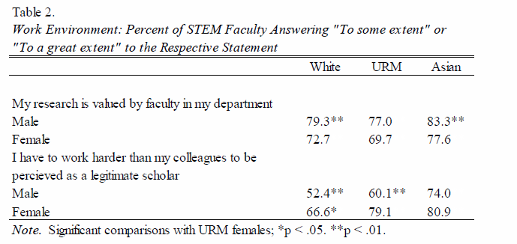
Value is a concern
SOURCE: Proceedings of National Academy of Sciences: Prepared for Seeking Solutions:
Maximizing American Talent by Advancing Women of Color in Academia, June 2012, Washington, DC.
Notes:
Due to these feelings of having to work harder than their male counterparts, there has been a rise in women acquiring part-time, no tenure positions in the US and Australia (Sheridan, 2005).

Slide 5
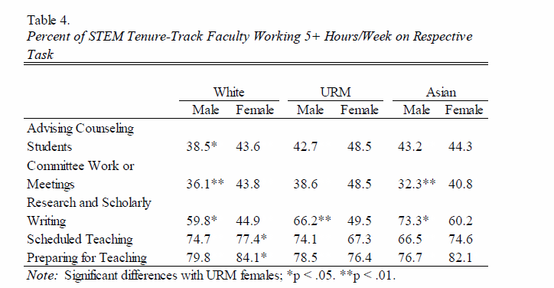
When the load is too great
SOURCE: Proceedings of National Academy of Sciences: Prepared for Seeking Solutions:
Maximizing American Talent by Advancing Women of Color in Academia, June 2012, Washington, DC.
Notes:
- The above chart shows that female faculty spend more time mentoring students and on committee work and less time on research than their male colleagues.

Slide 6
Top Ten Stressors
Table 3.
Percentage of Faculty By Race Responding Having Experienced “Somewhat” or an “Extensive” Amount of Stress
in the Last Two Years Due to the Following Stressors:
Top Ten Stressors for URM Female Faulty in STEM | URM Women | URM Men | White Women | White Men
Lack of personal time | 86.4 | 69.7** | 88.5 | 76.8**
Self-imposed high expectations | 82.4 | 79.4 | 88.0* | 79.5
Managing household responsibilities | 79.0 | 66.8* | 80.5 | 68.5**
Working with underprepared students | 69.9 | 63.3 | 74.5 | 69.6
Institutional budget cuts | 66.0 | 64.2 | 66.5 | 64.0
Personal finances | 65.8 | 65.7 | 59.6 | 57.9*
Research and publishing demands | 61.8 | 61.9 | 65.0 | 63.8
Institutional procedures and red tape | 61.0 | 62.6 | 67.2 | 68.9*
Teaching load | 61.0 | 56.3 | 68.3* | 60.0
Students | 58.5 | 51.7 | 69.6** | 60.1
Note: Significantly different from URM women faculty; *p< 0.5, **p<.01
SOURCE: Proceedings of National Academy of Sciences: Prepared for Seeking Solutions:
Maximizing American Talent by Advancing Women of Color in Academia, June 2012, Washington, DC.

Slide 7
Rates of women being promoted to higher ranks
Control and level of institution, gender | All ranks | Professor | Associate Professor | Assistant Professor | Instructor | Lecturer | No academic rank
Public | 394,898 | 100,250 | 83,744 | 84,006 | 67,418 | 21,787 | 37,693
4-year | 282,751 | 85,600 | 73,161 | 72,542 | 22,191 | 20,966 | 8,269
Men | 164,077 | 62,497 | 42,843 | 36,864 | 8,635 | 9,376 | 3,862
Women | 118,674 | 23,103 | 30,318 | 35,678 | 13,556 | 11,612 | 4,407
2-year | 112,147 | 14,650 | 10,583 | 11,464 | 45,227 | 799 | 29,424
Men | 51,127 | 7,115 | 4,793 | 4,905 | 20,846 | 328 | 13,140
Women | 61,020 | 7,535 | 5,790 | 6,559 | 24,381 | 471 | 16,284
SOURCE: U.S. Department of Education, National Center for Education Statistics, Integrated Postsecondary Education Data System
(IPEDS), Winter 2010 – 2011, Human Resources, Salaries Section
Notes:
Rates of women being promoted to higher ranks is low for 4 year institutions vs. 2 year institutions. Rates at public four year institutions are lower than that of 2 year institutions for both public and private (for profit) institutions.
There is a bump in high ranking females in academia in 4 year private (for profit) schools.

Slide 8
Increase* in Female Professors 2002 - 2007
Disparities exist in mathematics (assistant) and computer science (associate)
Nelson, 2010
Notes:
The above graph shows an increase in the percentage of female full professors across all displayed fields during the 5 year period. In all fields except math during this five year period, there is also an increase in the percentage of URM full professors (see supplemental slides 41 and 42).

Slide 9
Lack of diversity in tenure track faculty in US institutions
SOURCE: U.S. Department of Education, National Center for Education Statistics, Integrated Postsecondary Education Data System (IPEDS), "Fall Staff Survey" (IPEDS-S:93-99); and Winter 2009-10 and Winter 2011-12, Human Resources component, Fall Staff section. (This table was prepared July 2012.)
Notes:
This is the most recent data showing the total number of instructional faculty at post secondary institutions with tenure (Fall 2011).

Slide 10
The bottom line
Over the past 20 years, the tenure rate for female faculty members has been consistently lower (and at a slower pace) than their male counterparts across the board in varying types of institutions and fields of study.
Women make up only 27% of tenured faculty at four year degree granting colleges and universities.
The advancement to senior ranks has been stagnant over the last few decades
Notes:
Discussion point - What can be done to remedy this situation?

Slide 11
Things to consider
Expectations and guidelines should be clear
Department must give guidance
Differing academic institutions
Research intensive
Teaching focused
Liberal arts
Primarily undergraduate institutions (PUI)
Number of tenure rejections in the department/college/institution

Slide 12
Academic environments differ
Medical Schools
Arts & Science Campuses
Private/ Public
For promotion, one size does not fit all
Different cultures
Different rules/regulations
Different means of assessment

Slide 13
Levels of promotion
I. Pre-Promotion
Junior faculty (Assistant Professor) status
II. Promotion
Tenure status
Advancement to Associate Professor
III. Post-Promotion
Advancement to Full Professor
Notes:
For faculty working toward tenure and promotion, it is important to know the basics. If you start off at a different university, how many years will transfer? How many years do you have until you apply for tenure? When can you apply for full professorship after you are tenured? Questions like this should be discussed during your initial appointment.

Slide 14
Be prepared
Most importantly – read the departmental and college guidelines for promotion and tenure thoroughly
Will your department be revising the policy before you go up for tenure?
Notes:
Faculty should create a tenure checklist. This can be found in the supplemental materials if not provided by your institution.

Slide 15
I: Pre-promotion
1. Make expectations clear from day one
2. Formal and informal career advising
Possibly establish a mentoring program to ensure that new faculty are not only surviving
but thriving in this new environment
3. Essential elements of career advice
4. The Big Three
5. Mid-Career advice
Notes:
This slide outlines the responsibilities of the department chair and faculty during pre-promotions, all of which will be expounded upon in the coming slides.

Slide 16
1. Make expectations clear from day one
What is Day 1?
Interview
Foreshadow/communicate expectations
Second visit
provide specific details and tenure rates in the department/college/institution
When on board (provide written guidelines)
Provide a written (user friendly) guideline
Substantive steps
Timing
Be realistic (can’t do everything at once)
Make the guidelines supportive
clear articulation of the kinds of advising resources the new faculty has available to her/him)

Slide 17
2. Formal and informal career advising
Formal advising
Mentoring committees
Should start from the day a faculty member enters the department
Leadership should refer to best practices for junior faculty
Meet regularly (at least once/year)
Be available
Informal advising
Advising is not one-stop-shopping
Teaching
Teaching committee can perform peer review of teaching
Research
Writing (grants/papers)
Work-life balance
Departmental/university citizenship
Moral support
Other non-tenured faculty
Notes:
Department chairs should create opportunities for formal advising for their faculty. Faculty should seek out informal advising.
Not all faculty should be mentored the same way. By looking at best practices from other institutions, there will be a plethora of insight on this topic.
Moral support could be something as simple as going out for coffee and having a conversation about non-work related issues.
This slide would be a great time to discuss the importance of feedback at annual evaluations and an AAUW case study (i.e. Pam Lee and Jamie Perez).

Slide 18
Mentoring formats
One-on-one mentoring
Committee mentoring
Peer group: seminars, panel discussions
Academic performance and career development workshops
Zone mentoring (by area of expertise)
E-mentoring
Travel support to meet disciplinary mentor outside the university
Annual review meetings with chair and mentors
Wise Guys – use your senior faculty who may have some free time
Notes:
- Optional slide (see supplemental data for examples – best practices for faculty mentoring)

Slide 19
3. Essential elements of career advice
Timing is everything, so early on
Primary papers vs. reviews
Establish collaborations outside your PhD advisor
Submit early and often
1st paper should be submitted before arrival to institution
Funding
Foundations
National agencies
Early Career Awards
Internal opportunities
Notes:
Faculty should consider this essential career advice during pre-promotion.

Slide 20
4. The Big Three
Scholarship
Teaching
Service
Notes:
Faculty applying for tenure are typically judged by their record on scholarship, teaching, and service. The following slides outline a number of recommendations that faculty should keep in mind while striving for excellence in these three areas.

Slide 21
Scholarship
Diversify your research portfolio
What is a “top-tier” journal in your field
Balance of bread n’ butter papers and home runs
Start early (put your flag on the mountain)
Let the field know you’re at a new academic zip code
The first paper doesn’t have to be Beowulf
Encourage increasing exposure
Promote your new colleagues every chance you get
(i.e. support travel to conferences relevant the field)
Recruit students for your lab
Avoid publishing with previous PhD/Postdoc advisors
Establish collaborations outside your PhD advisor
The “line” on your CV that tenure reviewers will draw
Notes:
A “home run” paper is one where the data is collected and easy to write up for publication. Generally they may have other contributors that can help with the writing to make the submission process move faster. Home run papers will generally be cited heavily in the field. Bread and butter papers are those which are routine which contribute to the field but generally do not result in new findings that could revolutionize the field.
In terms of promoting your colleague, this could include inviting them to seminars and lectures and introducing them to other members in the academic community. This could possibly lead to future collaborations.

Slide 22
More on scholarship
The dual-edge sword of collaboration
Pluses: broadens impact, increases productivity
Minuses: the question of independence
Don’t be someone else’s “technician”
Make sure your contribution is clear and distinct before you begin
The thorny question of quality vs quantity
Again, balance is the key
Discuss with your department any tenure/promotion requirements
Publish at a steady pace: avoid “scalloping” as a run-up to tenure

Slide 23
A “soft reject”
Don’t give up on a paper/grant
“No” does not always mean “no”
Respond to reviewers of grants and papers
This can possibly lead to new research ideas
“In this game you don’t just need a strong mind. You need a strong stomach”

Slide 24
Teaching
The importance of advising
Don’t assume you know how
Use departmental resources (invite a colleague to sit in)
Use campus resources (college academic advisors)
Observe the best
“Watch” a good teacher or colleague who has been nominated/earned teaching awards
The first time is the hardest
Improvement is key
Attitude
Not a nuisance, not a favor
Universities have two missions
Possibility of teaching relief (e.g. in the first year)
Try to establish courses that are “your own”
Notes:
This section is very important for institutions where the teaching load is higher than at a research intensive university.

Slide 25
Teaching resources
Build a "village"
Establish team teaching courses as well. This reduces the work load and brings variety into the teaching field
Peer review
Establish a departmental teaching committee to visit new faculty classrooms to critique instruction
This should be a constructive process
Teaching and Learning Centers
Review of teaching from “teaching” experts.
Not based on content

Slide 26
Service (Department and College/University)
Department
Start out light
Try to find a learning experience for new faculty (e.g. a committee on which that they can learn policies/procedures)
Have the chairs of those committees see themselves as mentors to new faculty
College level and university-wide
Avoid early over-commitment
But take the opportunity to become known outside your department (e.g. at the School level, or the University level)
The importance of balance
Notes:
This section is also important for institutions that are not as research heavy.
Department chairs should play a role in matching new faculty with service opportunities within the department and ensuring new faculty have the mentoring they need from committee chairs. Meanwhile, faculty should work to make themselves know outside of the department through college level/university-wide service opportunities. However, faculty should ensure they don’t over-commit themselves too early.
Consider discussing the AAUW case of Samia Mansour in this section.

Slide 27
Service (Profession and Community)
Service to the Profession
Involvement in your professional organization
More than just attendance at the conference (mentoring and committee involvement)
Service to the Community
Participation in local events
Community outreach activities (i.e. science fair judging)
Check with your department for clarification (different perspectives)
Leadership roles of committees at all levels of service are important
Notes:
Faculty may also consider pursuing service opportunities outside of their home institution.
Warning - Women tend to be overcommitted in the service category which can lead to being overwhelmed.

Slide 28
Mid-Career Evaluation
Should be a formal evaluation
Is mandatory in some places
Who’s at the table during discussion of a candidate’s mid-career status (the value of young faculty learning by seeing how other
mid-career colleagues are evaluated)
Should be supportive but candid
Steps for improvement should be clearly spelled out (in writing)
Point out areas that need improvement
Provide clear steps to implement that improvement (i.e. develop an action plan)
The importance of follow-up
Create a time line
Meet regularly after mid-career evaluation (at least twice/year)
There should be no surprises
Comments/suggestions from previous evaluations should be followed
Notes:
Supportive, but candid evaluation is an important step in preparing faculty for the tenure and promotion process. Department chairs should strive to create a mid-career evaluation process based on the recommendations outlined on this slide.

Slide 29
II. Promotion to tenure
Preparing the document
Look at previous tenure applications (both successful and not successful)
Have it reviewed
If possible send a draft to a tenured faculty member
Prepare supporting materials
This takes time, so start early (~6 months before application submission)
Provide letters of support
Can come from previous students and/or collaborators
Ask for letters early
Notes:
- Faculty who are ready to apply for tenure should start early. It is recommended that faculty look at previous tenure application and ask a tenured faculty member to provide feedback on their application prior to submission. Additional advice for faculty applying for tenure follows on the next 4 slides.

Slide 30
II. Promotion to tenure
Choosing outside reviewers
The candidates list
The Committee’s complementary list
Some places, a third (independent) list is generated at the Dean’s level
Seeking advice
Talk to the Chair
Talk to all advisors/mentors/other faculty who have recently gone through the process

Slide 31
II. Promotion to tenure
Who’s at the table?
Some places have all faculty sit in on a tenure discussion
Listen to the committee report and subsequent discussion
Extremely valuable learning experience (demystifies the process)

Slide 32
Should I go up early?
Strong case: Go for it.
Know the deadlines!
Pros: increased rank, stature, and salary
If case could be stronger (often the case): wait
Risks of going up early: Repeated requests for outside letters
The psychological impact of a deferral or negative result (how will this impact the remainder of the academic year?)
Notes:
Talk to people that have gone up early for pointers (especially in your department, if possible). Is this frowned upon in your department?

Slide 33
Should I go up separately?
Some institutions allow faculty to go up for tenure and promotion separately or both at the same time
The criteria may be different
Bottom line: It depends.
Notes:
The candidate should seek advice from other colleagues to determine if they should go up for tenure and promotion separately. They should definitely discuss this matter with someone that has successfully applied for tenure and/or promotion separately or before they were required to do so.

Slide 34
III. Promotion to Full Professor
Post tenure
Participate on a study section
Accept more professional responsibility
e.g. scholarly societies, editorial boards, on SABs, etc.
Become a more engaged university citizen
serve on task-forces, Faculty senates, etc
Advancement to full professor
Learn the local culture of promotion
Post tenure evaluations
different e.g., in private and public institutions
Continue to seek advice from all who were helpful in the pre-tenure years
Notes:
Once faculty have received tenure, they have a new set of goals they need to achieve before promotion to full professor.

Slide 35
Take home messages
1. Careers never stop developing 2. Everyone benefits from advice at any stage in their career 3. Be proactive. Take note of suggestions/comments during previous evaluations. They should be used as constructive materials to prepare the tenure application

Slide 36
References
http://nces.ed.gov/fastfacts/display.asp?id=61
http://www.academia.edu/6132521/_Between_a_rock_and_a_hard_place_Women_faculty_at_striving_institutions
http://nces.ed.gov/programs/digest/2013menu_tables.asp
http://nces.ed.gov/programs/digest/d13/tables/dt13_315.20.asp
http://nces.ed.gov/programs/digest/d13/tables/dt13_316.80.asp
http://nces.ed.gov/ipeds/datacenter/
http://diverseeducation.com/article/49072/
http://www.pbs.org/shattering/theprogram.html
http://www.catalyst.org/knowledge/women-academia
http://chronicle.com/article/Almanac-2014-Profession/148157/
http://www.aaup.org/list-tables-and-figures-2013-14-annual-report-economic-status-profession
http://www.aaup.org/sites/default/files/files/2014%20salary%20report/Table11.pdf
http://www.aaup.org/sites/default/files/files/2014%20salary%20report/table12.pdf
http://www.catalyst.org/knowledge/women-academia
Nelson and Brammer, “A National Analysis of Minorities in Science and Engineering Faculties and Research Universities”, 2010.

Slide 37
Supplementary Information

Slide 38
Resources and Case Studies
American Association of University Women
www.aauw.org
“Tenure Denied: Cases of Sex Discrimination in Academia” (Montiegel, 2004)

Slide 39
Protection against Discrimination (Title VII)
Title VII of the Civil Rights Act of 1964 prohibits discrimination in employment on the basis of sex, race, color, national origin, and religion. It applies to public and private colleges and universities, labor organizations and employment agencies.
It applies to hiring, termination, promotion, compensation, job training, or any other term, condition, or privilege of employment.
Title VII also prohibits employment decisions based on stereotypes and assumptions about abilities, traits, or the performance of individuals on the basis of sex.
The law prohibits both intentional discrimination and neutral job policies and practices that disproportionately exclude individuals on the basis of sex and that are not job-related. Additionally, the prohibitions against sex discrimination in this law cover sexual harassment and pregnancy-based discrimination.
Notes:
This is a great place to discuss one of the case studies (scenarios) in the supplemental materials (i.e. Pam Lee (sexual discrimination), Janet Lever (Title VII), Jill Crystal (pregnancy discrimination).
Additional cases and updates may be found here: http://www.aauw.org/resources/by-type/laf-cases/

Slide 40
Filing a sexual discrimination complaint
You can file a sexual discrimination complaint under Title VII six months from the date of the last incident of harassment with the U.S. Equal Employment Opportunity Commission (EEOC).
You do not need an attorney to file a complaint with the EEOC.
The employer will be notified that a charge of discrimination has been filed and the EEOC will begin an investigation.
If a lawsuit is necessary, be realistic about the financial and emotional toll.
Develop a support system, so you do not have to go through the process alone.

Slide 41
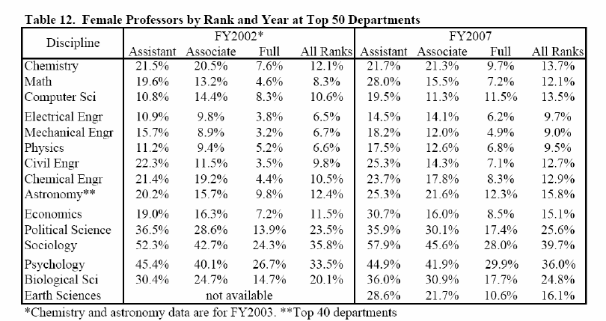
The Academic Pipeline
Nelson, 2010
Notes:
In all fields shown during this five year period, there is an increase in the percentage of female full professors.

Slide 42
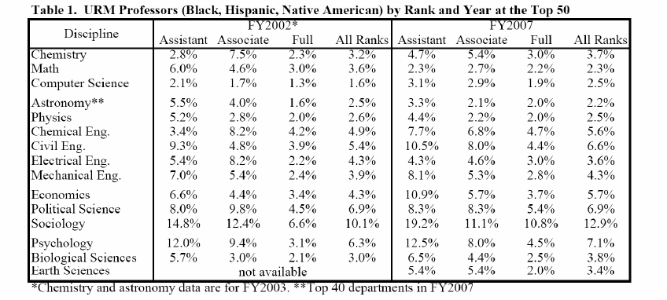
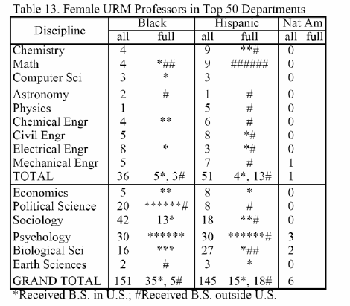
Underrepresented Minority Faculty
Nelson, 2010
Notes:
In all fields except math during this five year period, there is an increase in the percentage of URM full professors which is broken down in Table 13.

Slide 43
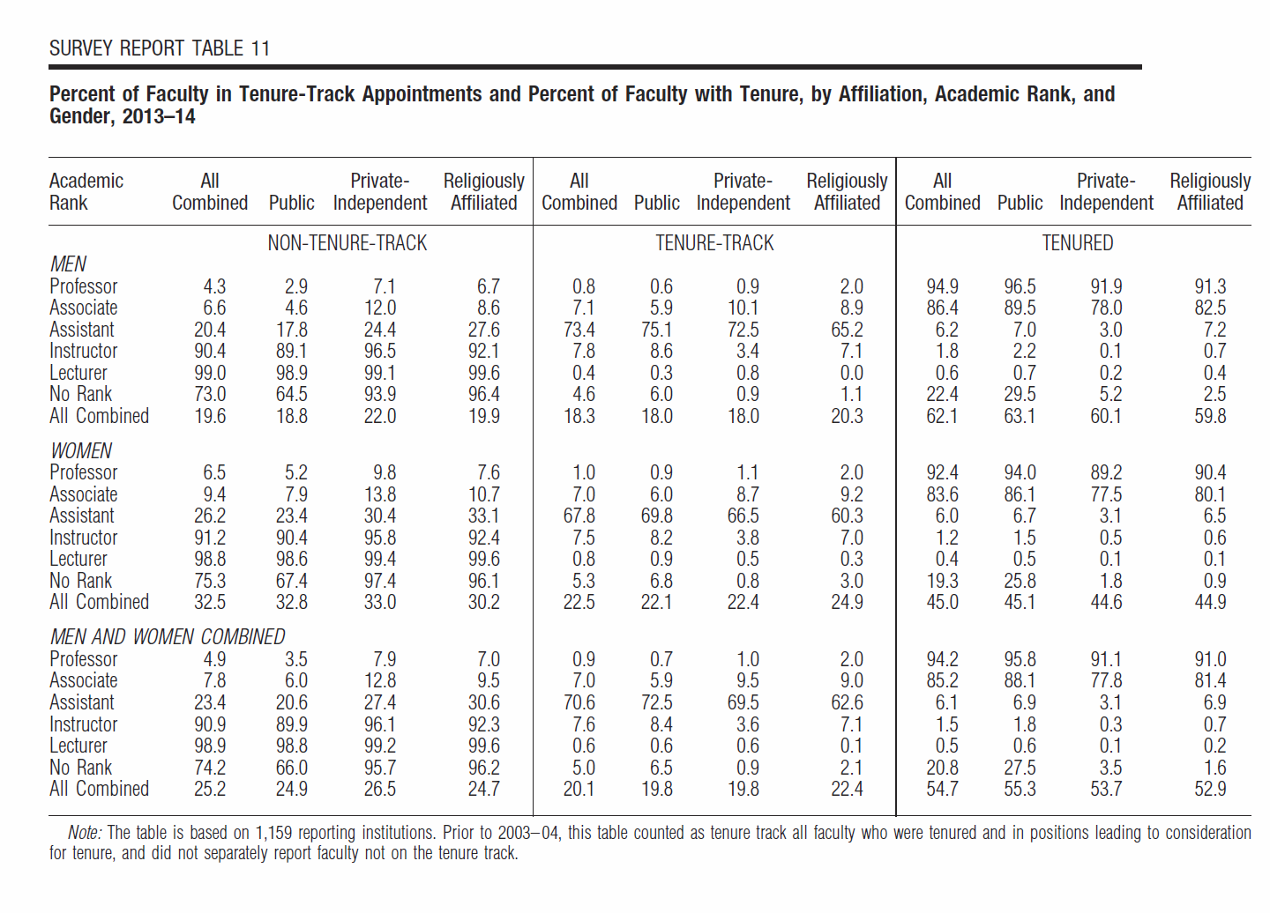
Percent of faculty based by affiliation, academic rank, and gender
http://www.aaup.org/sites/default/files/files/2014%20salary%20report/Table11.pdf
Notes:
AAUP salary report 2014

Slide 44
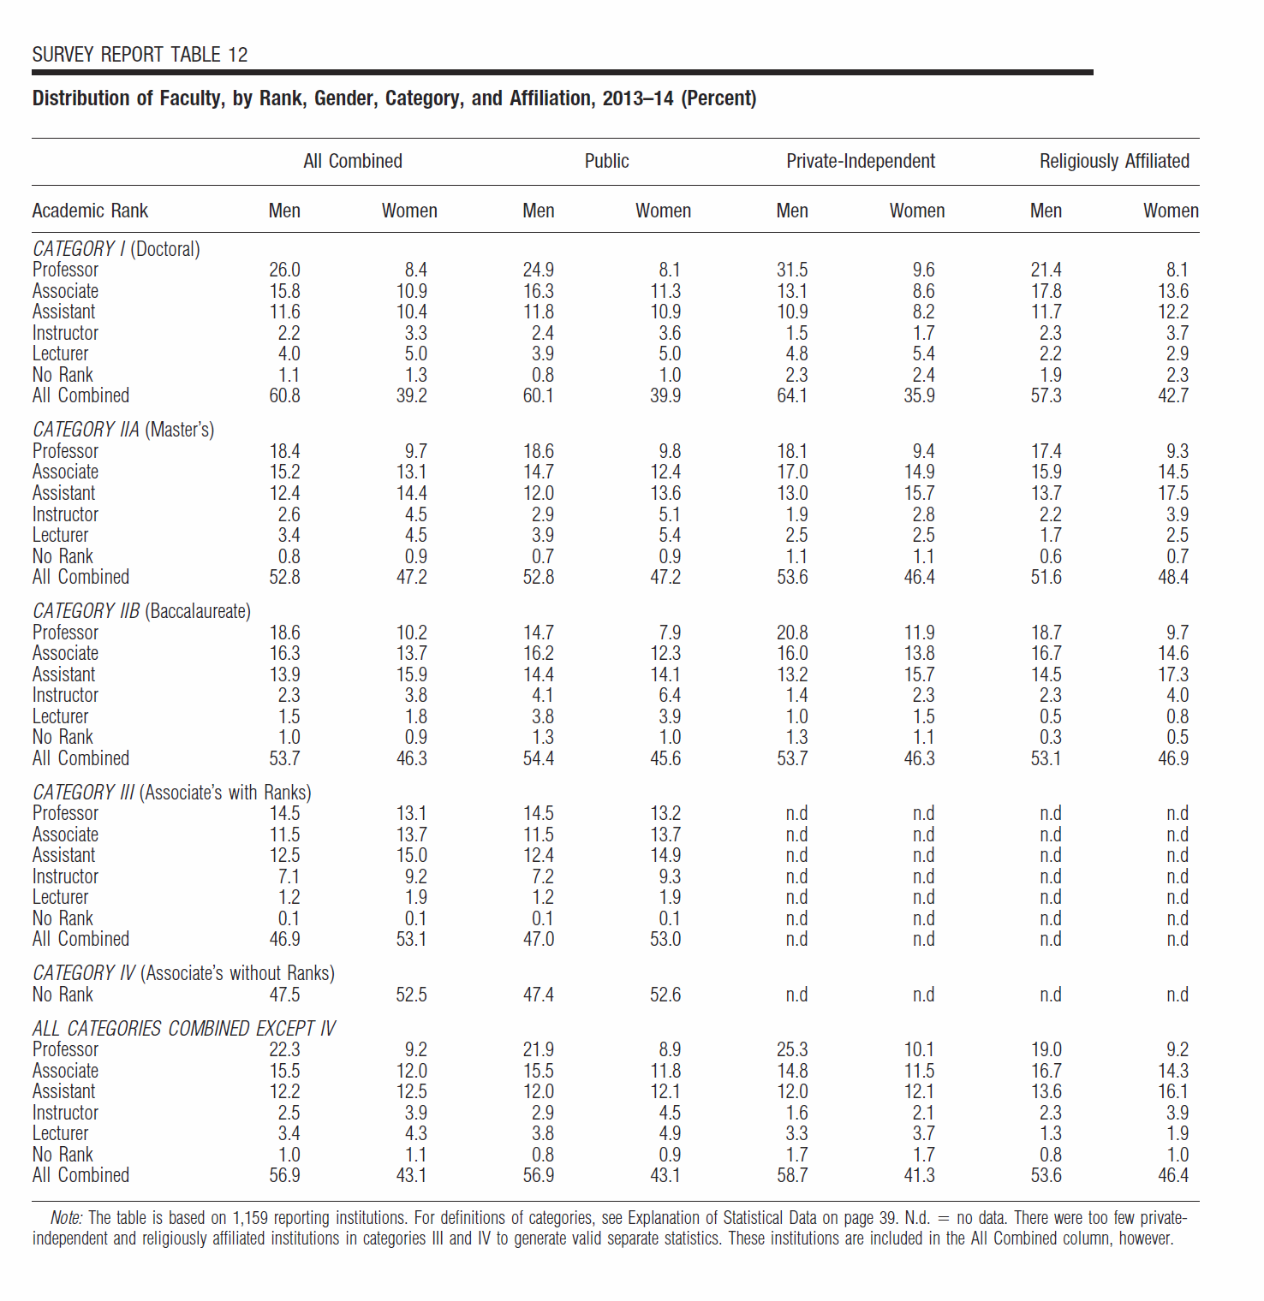
By affiliation, the story is still the same…
http://www.aaup.org/sites/default/files/files/2014%20salary%20report/table12.pdf
Notes:
AAUP salary report 2014

Slide 45
For those at teaching-focused institutions (If teaching scores are low…)
Be proactive
Don’t stick your head in the sand
Read student comments and make changes if needed
Ask for help
Consult fellow colleagues who are highly scored by students
Develop an action plan
If teaching is highly prioritized at your institution, develop a plan of improving teaching effectiveness

Slide 46
Best Practice of Faculty Mentoring
University of Michigan
Dept. chair and new faculty member develop a mentoring plan addressing teaching, graduate supervision, and research
Chairs fill out a section on mentoring in their annual reports.
Annual college-level meeting open to all tenure-track faculty to discuss the requirements for tenure and promotion and the P&T process
University of Pennsylvania
Each school designates a senior faculty person responsible for the management of the faculty mentorship program
Specific responsibilities and expectations of the mentor are clearly stated in the school’s policy and distributed to the junior faculty member along with the school’s promotion guidelines
Faculty mentoring considered as one of the university citizenship criteria for promoting senior faculty from Associate Professor to Full Professor
Stanford Medical School
Mentor assigned as soon as faculty member is hired; others may be added later by the faculty; mentors meet every six months with mentees
Diana Bilimoria, Best Practices in Faculty Mentoring, 2011
Notes:
Reference
http://www.case.edu/facultydevelopment/media/caseedu/faculty-development/documents/Best-PracticesinFacultyMentoring-11-11.ppt

Slide 47
UCSD Mentoring Program
Junior faculty participate in formal program consisting of a series of 16 workshops which cover:
counseling in defining career and research objectives
assistance with academic file preparation
introduction to the institutional culture
workshops on pedagogy and grant writing
instrumental, proactive mentoring by senior faculty
Program funded through National Centers of Leadership in Academic Medicine (NCLAM)
UCSD was one of four NCLAM selected in 1999.
Notes:
Reference
Daley, S. Wingard, D.L., Reznik, V. (2006) Improving the retention of underrepresented minority faculty in academic medicine. J Natl Med Assoc. 98(9):1435-40.
http://www.ncbi.nlm.nih.gov/pubmed/17019910
UCSD NCLAM Program
https://healthsciences.ucsd.edu/vchs/faculty-academics/faculty-affairs/nclam/nclam-program/Pages/default.aspx

Slide 48
Is Mentoring Cost Effective?
The UCSD program resulted in increased retention of faculty, especially URM and women, over 4 years
Improved retention rates translated to savings in recruitment (conservative estimate of $250,000 per recruitment) were greater than cost of the structured mentoring program ($670,000 over 4 years)
Actual cost return: $1.49 for every dollar spent
Wingard DL, Garman KA, Reznik V. Facilitating faculty success: outcomes and cost benefit of the UCSD National Center of Leadership in Academic Medicine. Acad Med. 2004 79(10 Suppl):S9-11
Notes:
Reference
Wingard DL, Garman KA, Reznik V. Facilitating faculty success: outcomes and cost benefit of the UCSD National Center of Leadership in Academic Medicine. Acad Med. 2004 Oct;79(10 Suppl):S9-11.
http://www.ncbi.nlm.nih.gov/pubmed/15383376
Daley, S. Wingard, D.L., Reznik, V. (2006) Improving the retention of underrepresented minority faculty in academic medicine. J Natl Med Assoc. 98(9):1435-40.
http://www.ncbi.nlm.nih.gov/pubmed/17019910

Slide 49
Mentoring Challenges and Actions to Address Them
Time challenges: the best mentors are very busy; and mentees sometimes don’t perceive their own time investment to be worthwhile
Action: Set a schedule of meetings and co-develop each agenda
Mentors and mentees to informally manage on their own
Actions: Establish guidelines and expectations
Provide oversight of the process
Increase accountability
Perceptions and expectations of mentoring differ between senior and junior faculty
Action: Discuss expectations early and often
Culture does not always support mentoring
Actions: Involve department chair and senior faculty throughout the process
Periodically discuss mentoring in departmental faculty meetings
Department size: sometimes just not enough senior faculty mentors
Action: Use a variety of mentoring practices
Associate to full professor mentoring often falls through the cracks
Action: Provide formal mentoring for associate professors
Notes:
In med schools -Spend time on K to R transition but not R to R
Reference
https://www.sfn.org/~/media/SfN/Documents/Professional%20Development/IWIN/DC%202010%20%20Climate%20Presentation.ashx
http://www.case.edu/facultydevelopment/media/caseedu/faculty-development/documents/Best-PracticesinFacultyMentoring-11-11.ppt

