Slide 1
Aha!
Creative problem solving in the brain
Mark Beeman
Psychology & Neuroscience, Northwestern University
Puzzles
solutions given in talk
– work on these ahead of time, but don’t look up answers

Slide 2
Lightbulb
On a wall outside a closet door are 3 standard on/off switches. One (and only one) controls a light bulb inside the old, but light-tight, well-insulated closet. The other two switches do nothing. You have only 5 minutes, you can only open the closet door once, and cannot change any switches after the door is open (or re-closed, for that matter). Damaging or disassembling the door, walls, or switches is against the rules.
Within these constraints, how can you determine with certainty which switch controls the light bulb?
Notes:
Turn on one lightswitch for a couple minutes, then turn it off, turn on a second switch and open the door.
If the lightbulb is on it is the switch you just flipped, if it is off and warm it’s the first switch you flipped, and if it is off and cool it is the swi

Slide 3
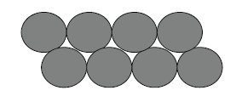
Eight coins in two rows
Imagine 8 coins arranged above. Move exactly 2 coins, so that in the new arrangment each coin touches exactly 3 others
Move exactly 2 coins, so that each coin touches exactly 3 others
Move exactly two coins in order to find a constellation where each coin touches exactly three other coins.
Move exactly two coins in order to find a constellation where each coin touches exactly three other coins.
Move exactly two coins in order to find a constellation where each coin touches exactly three other coins.

Slide 4
Find the forged coins
An innocent coin dealer has 10 bags, each bag containing 10 “ancient coins”. He believes that these are all real, but you know that one bag, from one counterfeiter, contains nothing but forgeries. The other 9 bags contain all real coins.
The original coins all weigh 1g, forgeries = 1.1g
You’re allowed to touch the coins and examine them more closely, even outside the bags, but they all feel and look too similar to distinguish
With just one reading (i.e., can only get a single number) on an accurate digital scale, how can you discover which bag contained forgeries?
( Think about it, talk it over, but don’t give away the answer! )

Slide 5
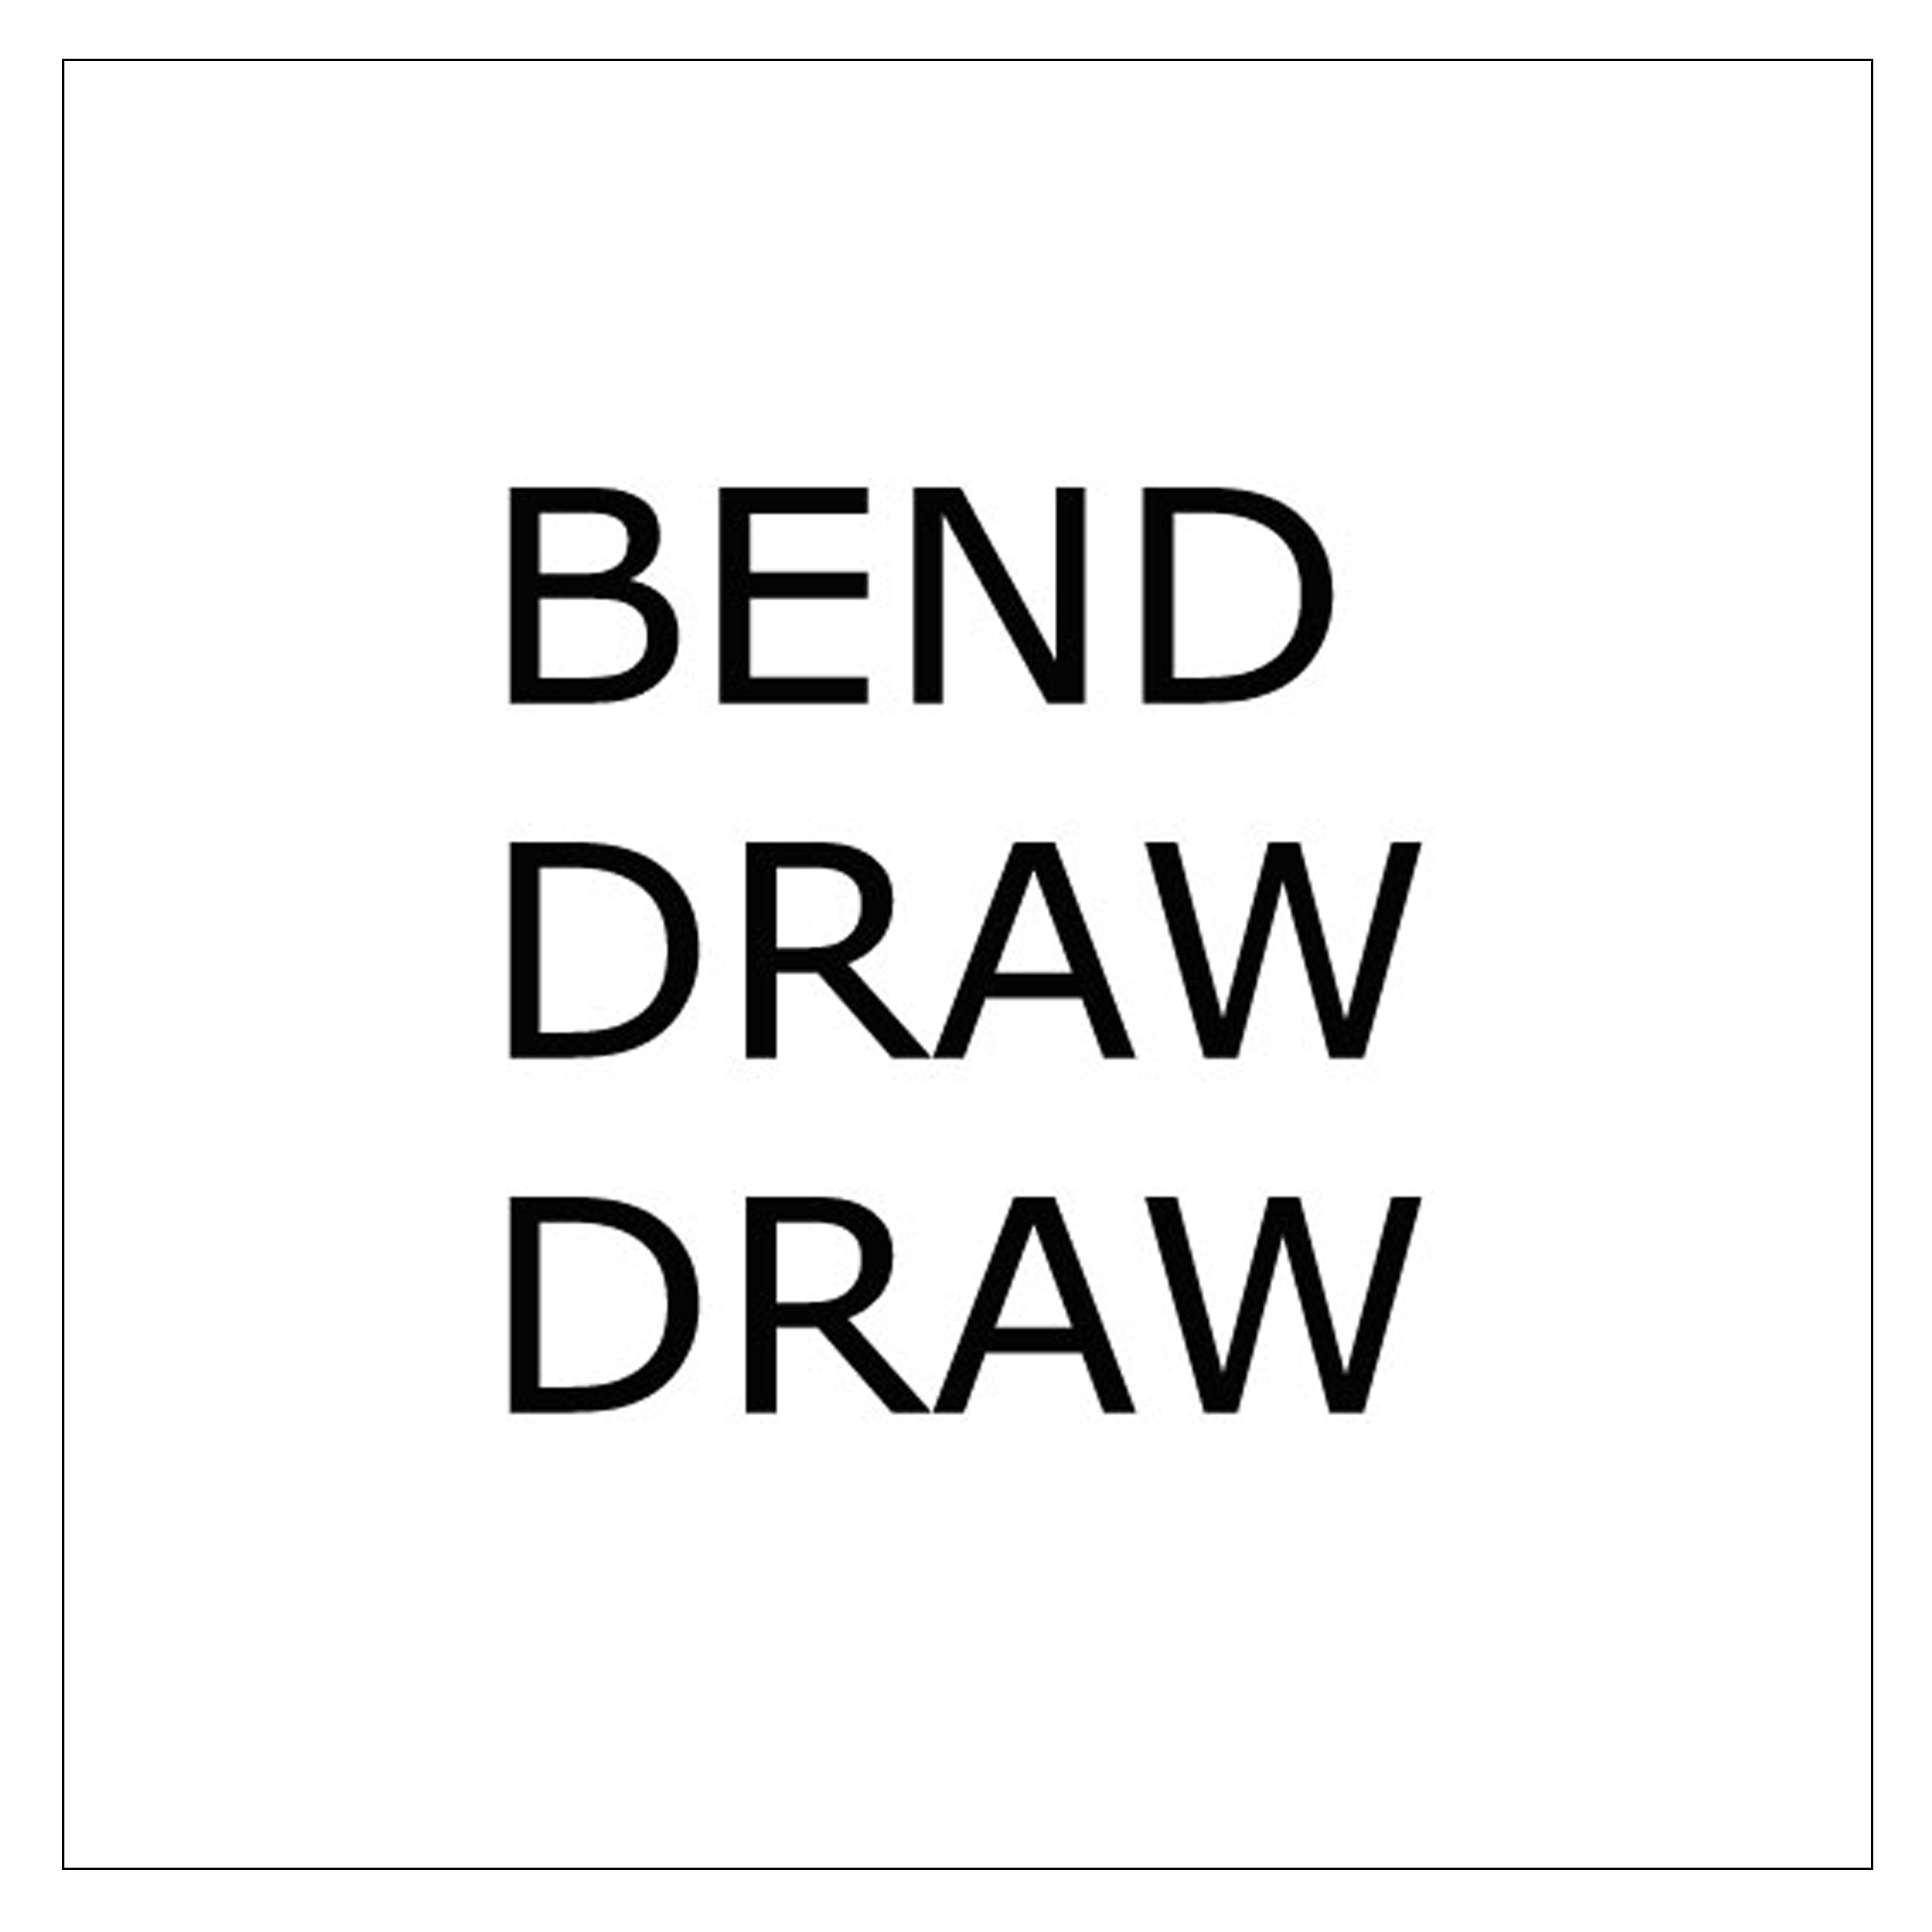
:
Rebus problems (example):
In the box are letters or words, arranged to reflect a common phrase. For instance, the one below is “bend over backwards”

Slide 6

Rebus problems:
What familiar phrase is represented in the box ?

Slide 7
tooth heart potato
CRA problems:
What single solution word can form a compound word or familiar two-word phrase with each of the words in the box ?

