Slide 2
The Senses
How We Experience the World

Slide 3
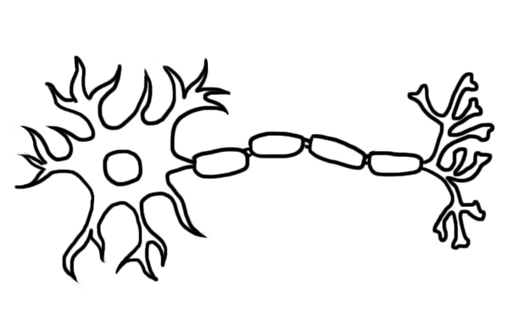
Brain Cells
Axon
Neurotransmitters
Dendrites
Axon terminals
Notes:
The brain is made up of 86 billion neurons.
Neurons are cells with special communications hardware: axons and dendrites.
Axons carry electrical pulses from the cell’s body to the axon terminals.
Axon terminals release chemical messengers called neurotransmitters.
The neurotransmitters are detected by receptors on the dendrites of the next cell.

Slide 4
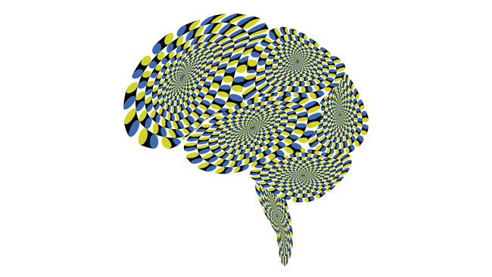
Optical Illusions
Notes:
What do you see here?
The image above is a brain-shaped version of a known “rotating snakes” optical illusion by Akiyoshi Kitaoka, a professor of psychology at Ritsumeikan University in Kyoto. Normally presented as concentric circles of distinct gradients, the image creates the illusion of rotation to many viewers.
Researchers set out to determine whether this illusion is the result of small, jerky, involuntary movements your eyes normally make as they look at an object. The researchers surmised that these movements paired with sharp, repetitive contrasts in the image trigger a motion signal in the brain, tricking you into thinking a stationary image is spinning — or slithering.
Image of the Week Snakes on a Brain: http://www.brainfacts.org/thinking-sensing-and-behaving/vision/2012/image-of-the-week-snakes-brain

Slide 5
1. Vision
Everything you ever see is due to a massive network of neurons in your eyes and your brain.
To be able to see anything, eyes first need to process light.
Vision begins with light passing through the cornea, which does about three-quarters of the focusing, and then the lens, which adjusts the focus.
Notes:
- Everything you ever see is due to a massive network of neurons in your eyes and your brain.
- To be able to see anything, eyes first need to process light.
- Vision begins with light passing through the cornea, which does about three-quarters of the focusing, and then the lens, which adjusts the focus.
- Photoreceptors are neurons specialized to turn light into electrical signals. The signals have to first travel to your brain along the optic nerve.
-- The signals from the eye travel to the visual areas at the back of the brain, exciting neurons in the occipital lobe.
- Two major types of photoreceptors are rods and cones.
-- Rods are extremely sensitive to light and allow us to see in dim light, but they do not convey color.
-- The human eye contains three types of cones (red, green, and blue), each sensitive to a different range of colors.
(Optional) Pause here to show your students the Do We See The Same Red video linked in the Power Point Notes: http://www.brainfacts.org/thinking-sensing-and-behaving/vision/2016/do-we-see-the-same-red-051716

Slide 6
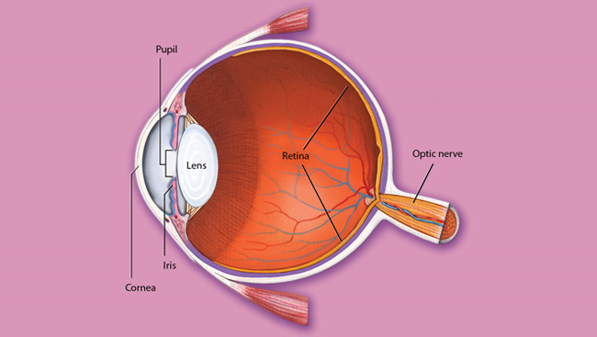
1. Vision
Notes:
- The retina is a multilayered sensory tissue that lines the back of the eye and contains the receptor cells to detect light.
- The retina contains three organized layers of neurons.
The rod and cone photoreceptors.
The middle layer.
Several types of ganglion cells.
The axons of the ganglion cells form the optic nerve.
- The iris controls the pupil, which regulates how much light enters the eye.

Slide 7
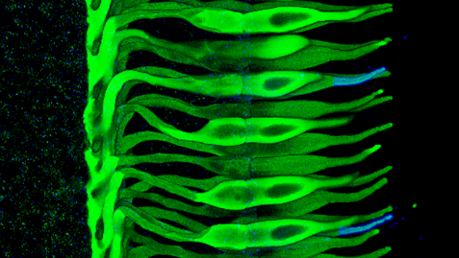
1. Vision
Notes:
The image above shows cones in the primate retina. All the cones were labeled to appear green. The blue cones have blue tips. The light-sensitive tips of the cells are on the right side of the image.
Image Credit: Jennifer J. O'Brien, Xiaoming Chen, Peter R. MacLeish, John O'Brien, and Stephen C. Massey. Photoreceptor Coupling Mediated by Connexin36 in the Primate Retina. The Journal of Neuroscience, 28 March 2012, 32(13):4675-4687.
Vision: It All Starts With Light http://www.brainfacts.org/thinking-sensing-and-behaving/vision/2012/vision-it-all-starts-with-light

Slide 8

Did You Know?
Neuroscientists believe motion sickness occurs when a person has mismatched sensory systems.
Notes:
Neuroscientists believe motion sickness occurs when a person has mismatched sensory systems.
For some people when their vision system and their hearing system disagree about their sense of movement, they experience a feeling of nausea and dizziness.
An example of motion sickness is reading in a moving car. While your eyes focus on a stationary book, but your ears pick up the sound movement outside of the car.

Slide 9
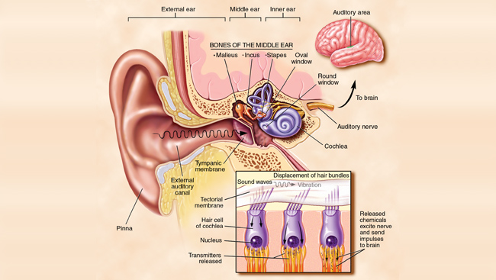
2. Hearing
Notes:
Sound waves are collected by the external ear and funneled to the eardrum (tympanic membrane) to make it vibrate.
Attached to the eardrum, the hammer (malleus) transmits the vibration to the anvil (incus), which passes the vibration on to the stapes.
The stapes pushes on the oval window, which separates the air-filled middle ear from the fluid-filled inner ear to produce pressure waves in the inner ear’s snail-shaped cochlea.
A high note causes one region of the cochlea’s basilar membrane to vibrate, while a lower note has the same effect on a different region of the basilar membrane.
Riding on the vibrating basilar membrane are hair cells. Hair cells convert the mechanical vibration to electrical signals, which in turn excite the fibers of the auditory nerve.
The auditory nerve then carries the signals to the brainstem. From there, nerve fibers send the information to the auditory cortex, the part of the brain involved in perceiving sound.
In the auditory cortex, adjacent neurons tend to respond to tones of similar frequency. However, they specialize in different combinations of tones.
Some respond to pure tones, such as those produced by a flute, and some to complex sounds like those made by a violin.
Some respond to long sounds and some to short, and some to sounds that rise or fall in frequency.
Other neurons might combine information from these specialist neurons to recognize a word or an instrument.

Slide 10
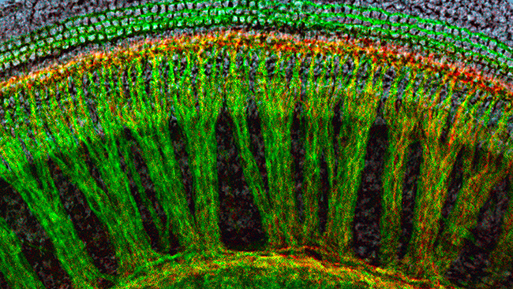
2. Hearing
The cochlea is responsible for the separation of frequencies.
Notes:
The cochlea is responsible for the separation of frequencies.
The cells in the cochlea are arranged like a wagon wheel, as seen in the above image in a mouse brain. The green “spokes” carry signals to the brain while the cells in red send signals back from the brain to the cochlea. Scientists now know that the cells in red are particularly important for protecting hearing.

Slide 11

Tasting Letters
For people with the rare condition known as synesthesia their senses mix!
S =
Notes:
- For people with the rare condition known as synesthesia their senses mix!
- People have reported tasting letters. For example, one person with synesthesia claims the letter "S" tastes sweet, like candy while "W" tastes blank, like water.
- To learn more about synesthesia watch “Hearing Red, Tasting Blue” by Akshay Balaji, a high school student from the United States. http://www.brainfacts.org/thinking-sensing-and-behaving/thinking-and-awareness/2016/hearing-red-tasting-blue-when-the-senses-mix-090216

Slide 12
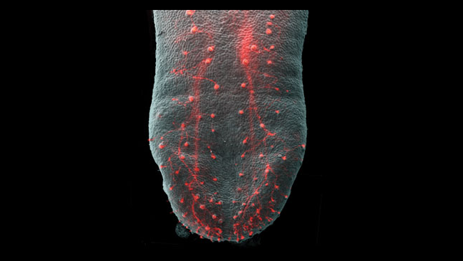
3. Taste
Every person has between 5,000 and 10,000 taste buds. Each taste bud consists of 50 to 100 specialized sensory cells, which are stimulated by tastants such as sugars, salts, or acids.
Notes:
Tastants, chemicals in foods, are detected by taste buds, which consist of special sensory cells.
When the sensory cells are stimulated, they cause signals to be transferred to the ends of nerve fibers, which send impulses along cranial nerves to taste regions in the brainstem.
From here, the impulses are relayed to the thalamus and on to a specific area of the cerebral cortex, which makes us conscious of the perception of taste.
Taste itself is focused on distinguishing chemicals that have a sweet, salty, sour, bitter, or umami taste (umami is Japanese for “savory”).
Every person has between 5,000 and 10,000 taste buds. Each taste bud consists of 50 to 100 specialized sensory cells, which are stimulated by tastants such as sugars, salts, or acids.
Highlighted in red is the gustatory system, or sense of taste.
Image Credit: Liqun Ma, Grace F. Lopez, and Robin F. Krimm, The Journal of Neuroscience, March 18, 2009, 29(11):3354-3364.

Slide 13

Did You Know?
Taste and smell are separate senses with their own receptor organs, yet they are intimately entwined.
Notes:
- Taste and smell are separate senses with their own receptor organs, yet they are intimately entwined.
- This close relationship is most apparent in how we perceive the flavors of food. As anyone with a head cold can attest, food “tastes” different when the sense of smell is impaired.
- Ultimately, messages about taste and smell converge, allowing us to detect the flavors of food.
READ: Taste and Smell http://www.brainfacts.org/thinking-sensing-and-behaving/taste/2012/taste-and-smell

Slide 14
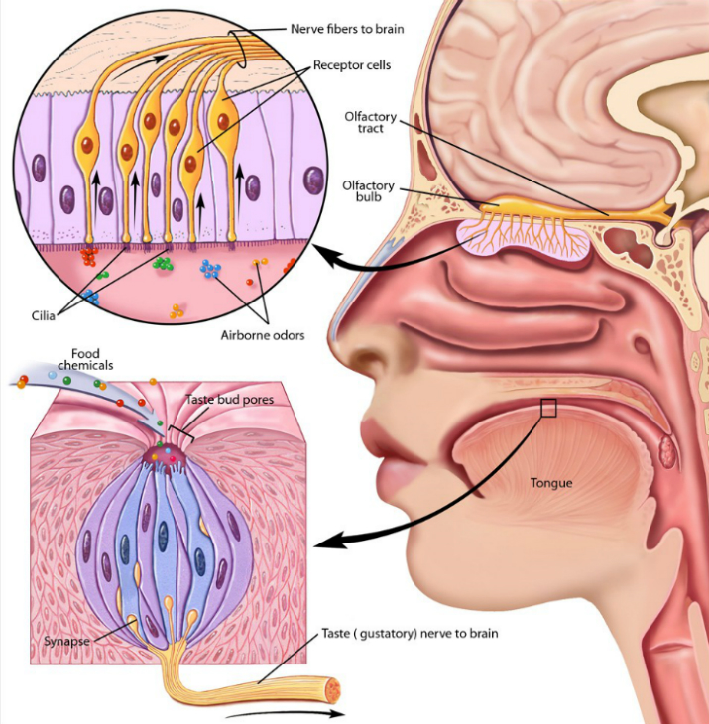
4. Smell (and Taste)
Notes:
- Airborne odor molecules, called odorants, are detected by specialized sensory neurons located in a small patch of mucus membrane lining the roof of the nose.
- Axons of these sensory cells pass through perforations in the overlying bone and enter two elongated olfactory bulbs lying against the underside of the frontal lobe of the brain.
- Odorants stimulate receptor proteins found on hair-like cilia at the tips of the sensory cells, a process that initiates a neural response.

Slide 15

4. Smell
Notes:
- Most sensory information passes through the thalamus before it is processed in the cerebral cortex. Except smell.
- The sense of smell (olfaction) is processed in the frontal cortex.
- The inability to smell or perceive odor is called anosmia.
- Scientists still know very little about anosmia and are still far from a cure, but what they do know is that somewhere between your nose and frontal cortex information is being lost.
- (Optional) Pause here to show your students the Congenital Anosmia video http://www.brainfacts.org/thinking-sensing-and-behaving/smell/2013/congenital-anosmia

Slide 16
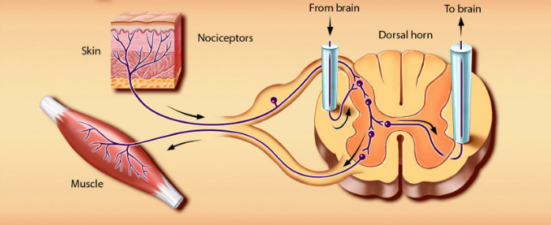
5. Touch
Notes:
- Touch is the sense by which we determine the characteristics of objects: size, shape, and texture.
- We do this through touch receptors in the skin. In hairy skin areas, some receptors consist of webs of sensory nerve cell endings wrapped around the base of hairs.
-- The nerve endings are remarkably sensitive.
- Signals from touch receptors pass via sensory nerves to the spinal cord, where they synapse, or make contact with, other nerve cells, which in turn send the information to the thalamus and sensory cortex.
Touch and Pain http://www.brainfacts.org/thinking-sensing-and-behaving/touch/2012/touch-and-pain

Slide 17
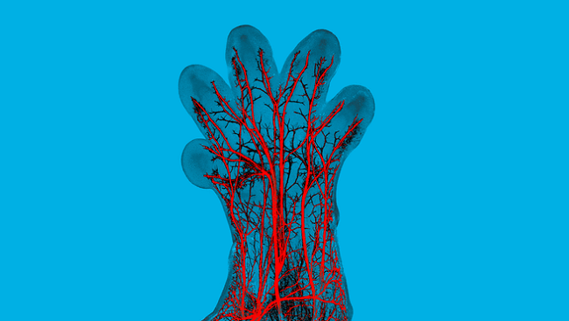
5. Touch
Notes:
In this image, sensory nerve fibers (red) can be seen in the paw of a developing mouse embryo. Each of these nerve fibers will become specialized to detect either pressure, pain, temperature, or itch, providing important information about the world around us.

Slide 18

But Wait, There’s More!
Proprioception is often referred to as the sixth sense, which can sound a bit like a superpower.
Notes:
Title: Fresh Creative Commons Photography 25 Best Ideas About Superhero Silhouette On Pinterest
Upload by: Kayaken
Upload date: February 21, 20174Image
link: http://big5kayakchallenge.com/wp-content/uploads/2018/01/fresh-creative-commons-photography-25-best-ideas-about-superhero-silhouette-on-pinterest-creative-commons-photography.jpg

Slide 19
6. Proprioception
Proprioception is your sense of the relative positions of your body parts and the effort being put into movement. Without proprioception you wouldn’t be able to walk or scratch your nose with your eyes closed.
The brain also relies on cutaneous mechanoreceptors located in the skin for information about stretch, pressure, and vibration. These receptors also help with sensing joint position and movement.
Notes:
For more information on proprioception watch “Your Sixth Sense” by Alison Caldwell http://www.brainfacts.org/thinking-sensing-and-behaving/thinking-and-awareness/2016/your-sixth-sense-051916

Slide 20

Follow BrainFacts.org
@Brain_Facts_org
https://www.facebook.com/BrainFactsOrg

